Slide 1
Answers’ Gang

Slide 2
Team members
Ahmed Osama Omar Nasr Mohammed Anwer Ihab Tawffiq

Slide 3
Hello!
I am Ihab Tawffiq
I am here because I love to give presentations.
You can find me at ihab.tawffiq@outlook.com

Slide 4
Why Answers’ Gang
Let’s start with the first set of slides

Slide 5
To help people communicate with each other in an easy and simple way
All you have to do is create an account and you are good to go !

Slide 6
Why Answrs’ Gang (Cont.)
You can add answers and questions for any category you want.

Slide 7
Answers’Gang
Gang will serve gang will be of service

Slide 8

Take a break before viewing the map

Slide 9
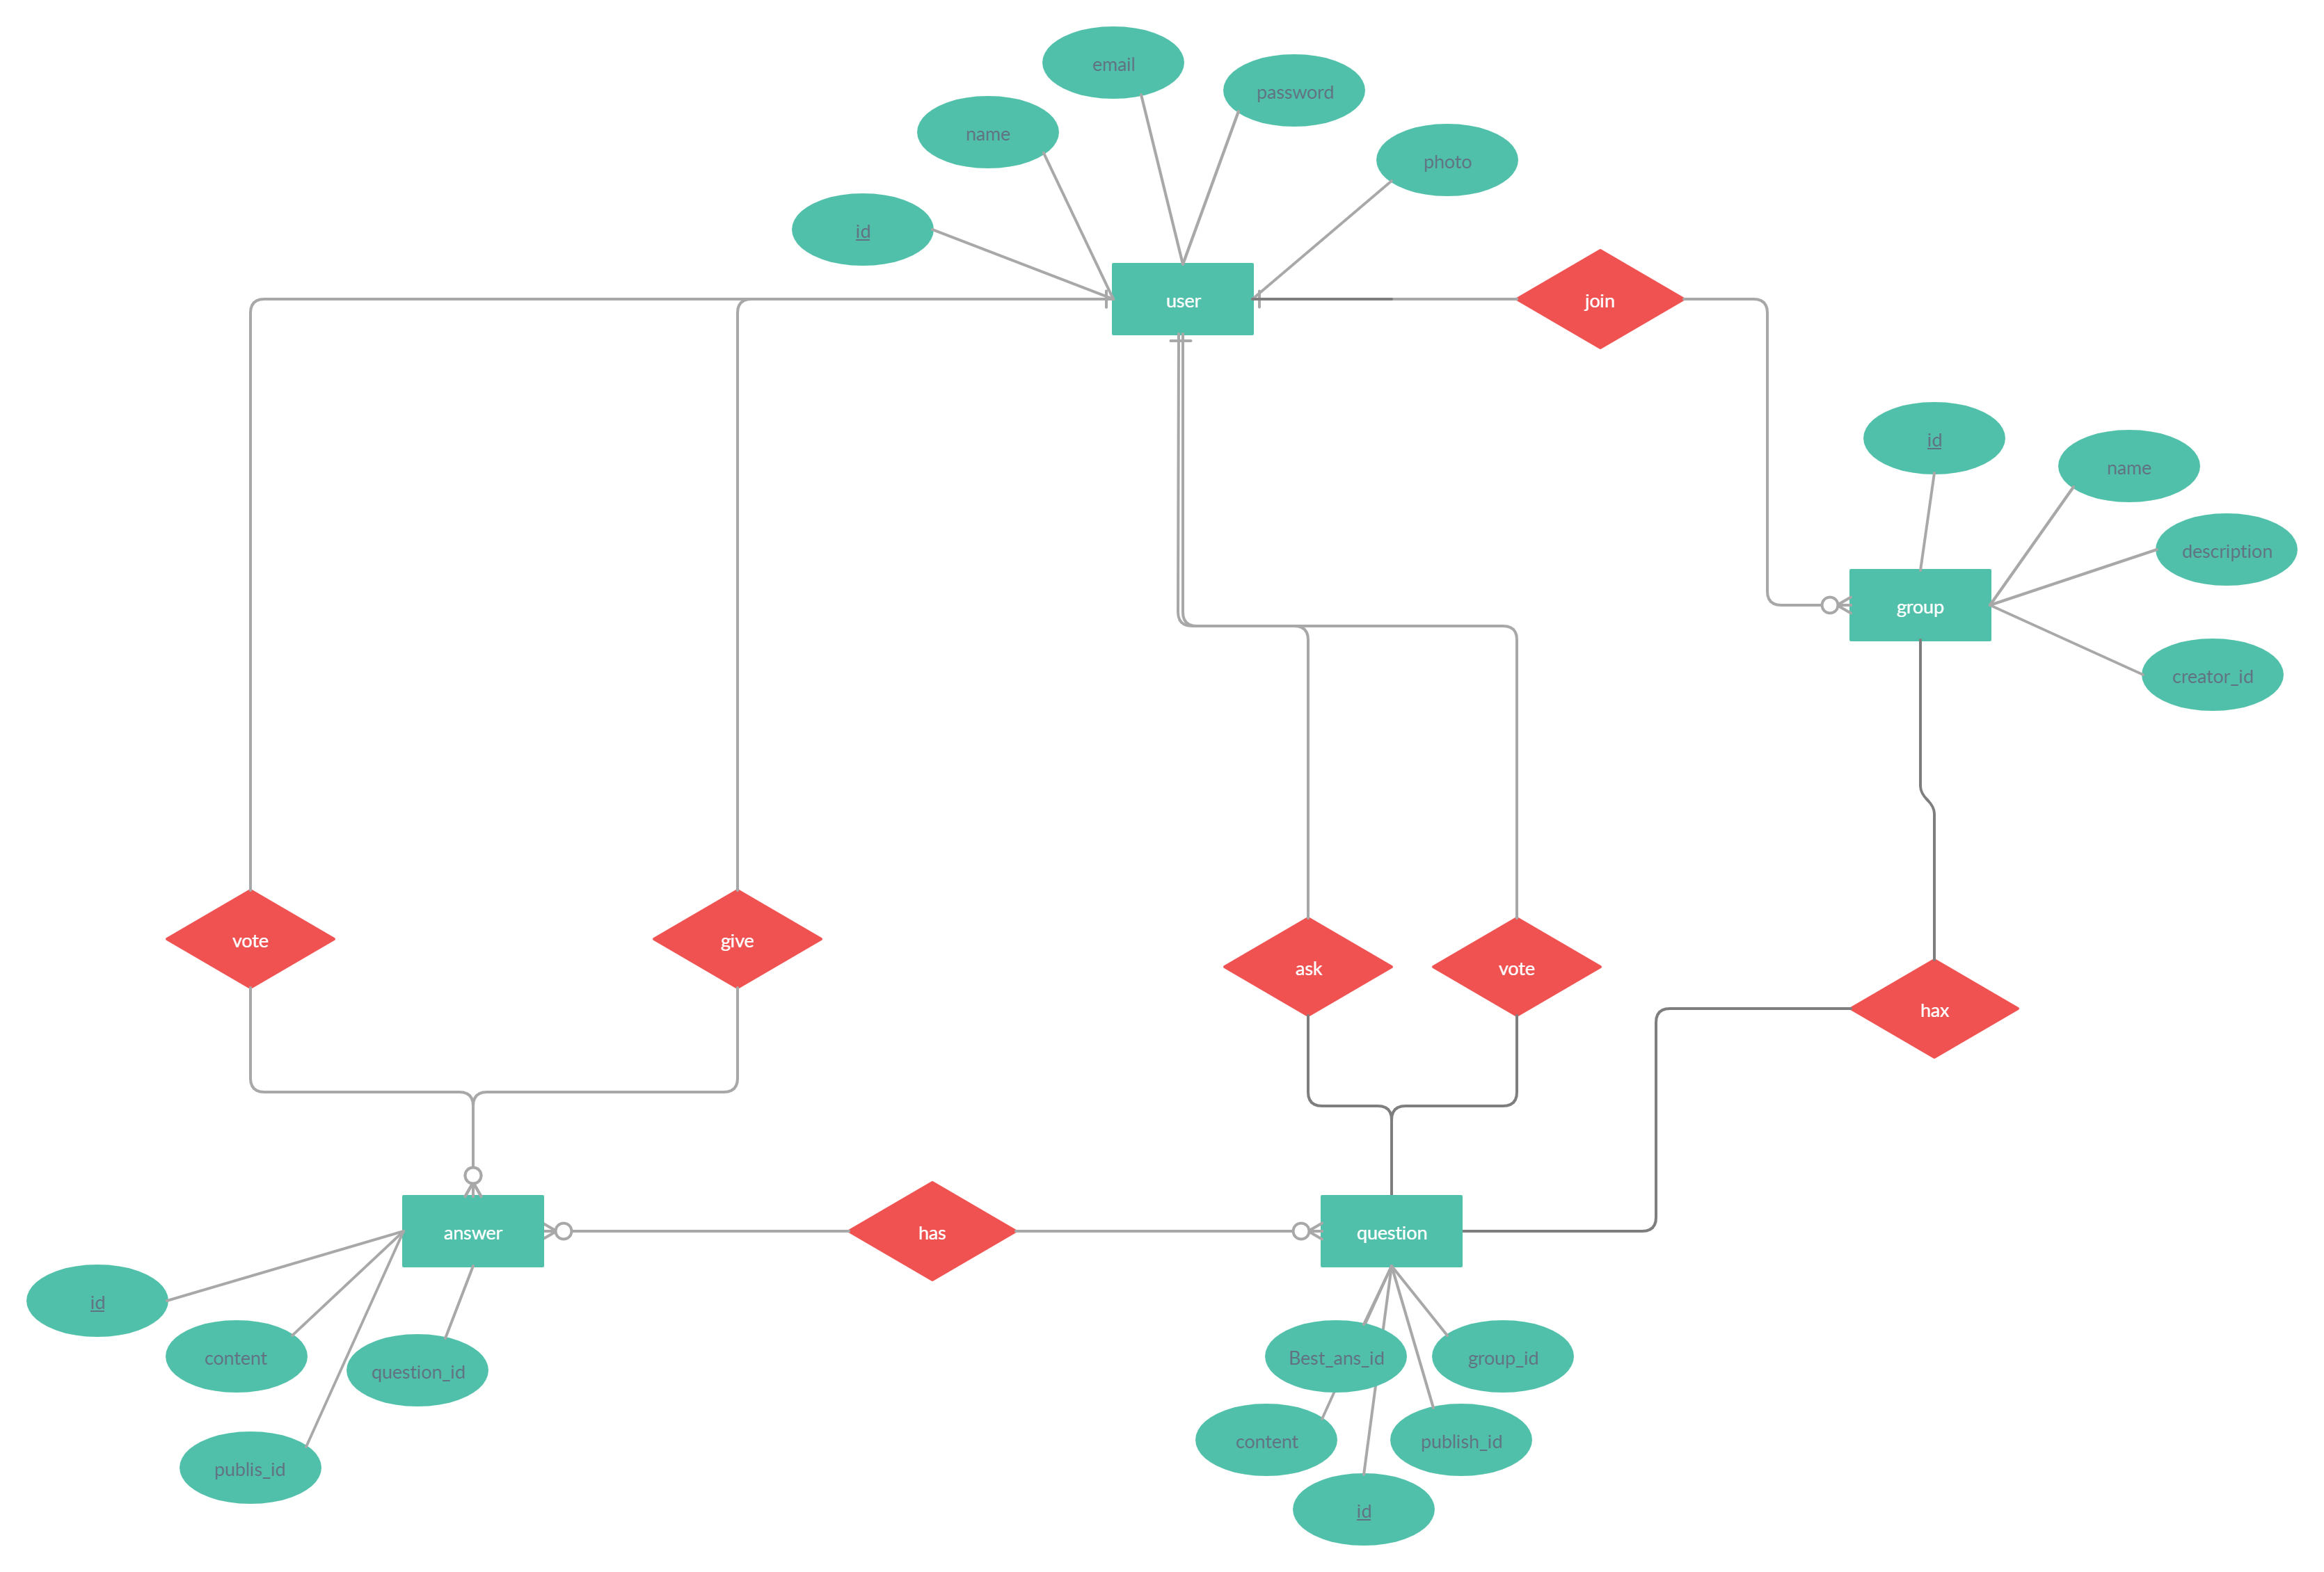
A picture is worth a thousand words
ERD

Slide 10
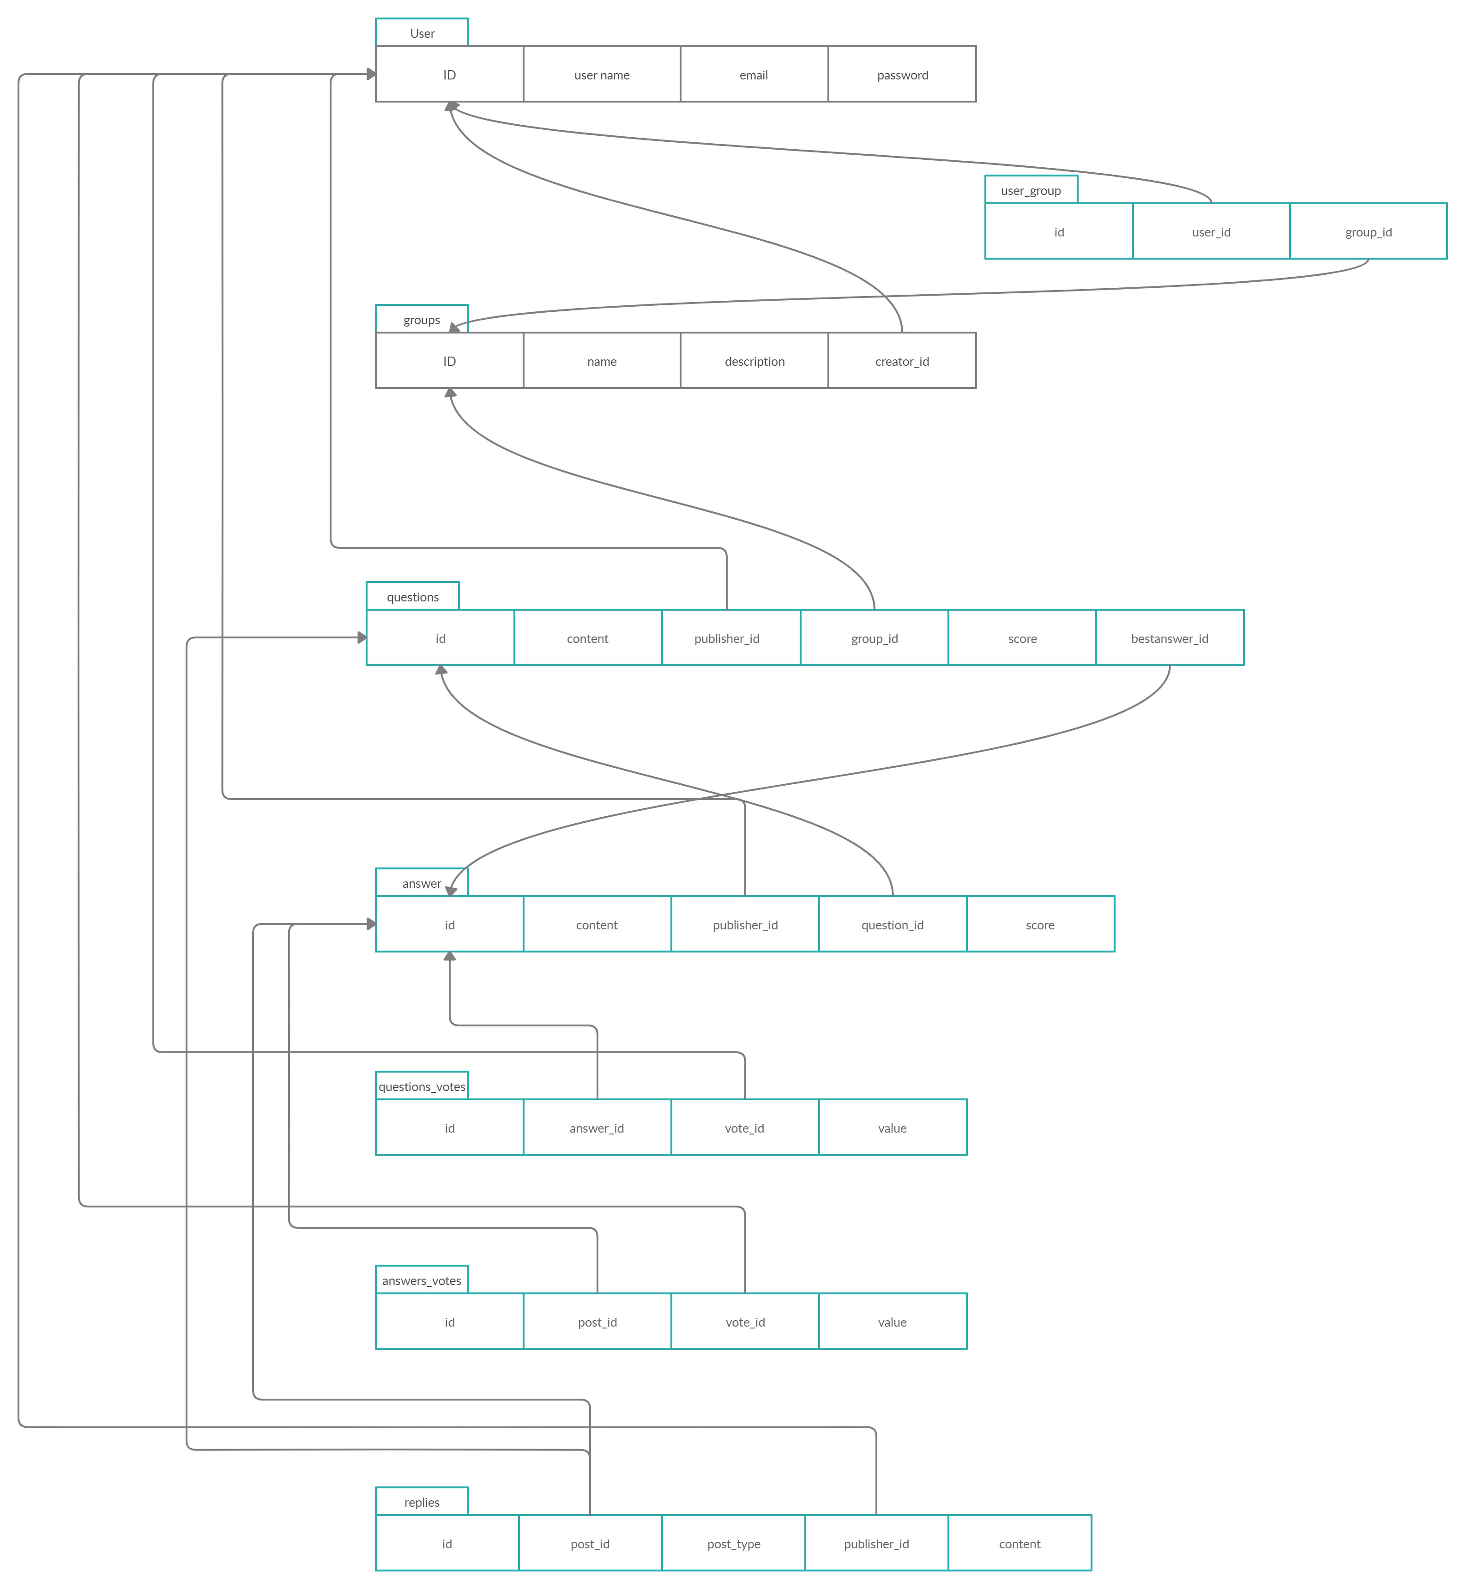

Slide 11
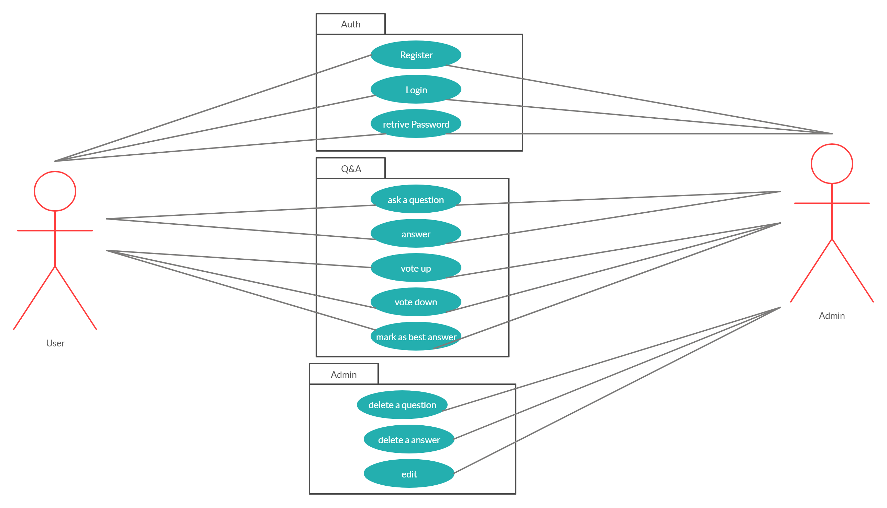
Use Case

Slide 12
Thanks!
Any questions?
You can find us at:
Ihab.tawffiq@outlook.com
o.nasr1234@gmail.com
Ahmed.osama.iv@gmail.com
m.messi.a21@gmail.com

